Slide 1
The Environmental Impact Of Software
Christian Abegg
Notes:
Christian
Cloud Architect at Zühlke.
Love job
Useful
contribute to Progress humand kind
No really, fantastic
Learn new stuff all the time – like here when attending meetups
Play around with the latest gadgets!
BUT
There is also a downside to the sector we are working in – its environmental impact.
and that's what I'd like to talk about today

Slide 2
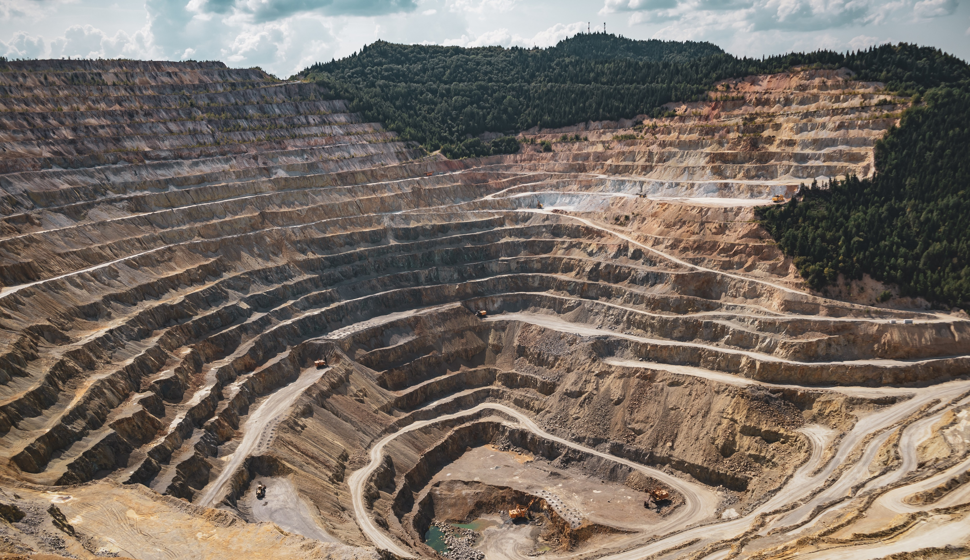
EXTRACTING RESOURCES
Pic: Vlad Chețan
Notes:
One major impact on the environment is the extraction of ressources.
There’s a lot of effort needed to get what we need to build the IT equipment
Therefore, the biggest machines humans built do this work.
For example gold:
This golden ring caused about 20 tons of mine waste – consisting of waste rocks and toxic heavy metals
This laptop weights about 2kg
And it requires about 800kg of resources.
A laptop consists of about 50 different materials –they are distributed all over the earths crust.
And they are getting harder and harder to find, it’s like the easter egg problem – the easy ones are already discovered.
and the less that is in the earth, the more effort we have to put into excavating them.
And on the long term, a “chip shortage” like we had it after the pandemic
is only a pretaste what we are facing when we run out of resources.
All in all, the extraction work leads
to soil pollution – extracting the valuable material requires toxic metals
to air pollution – operating the huge machines burns fossil fuels
to water pollution
Source 20tons: https://earthworks.org/assets/uploads/archive/files/publications/20TonsMemo_FINAL.pdf
https://www.pexels.com/photo/mining-excavation-on-a-mountain-2892618/

Slide 3

FRESHWATER USAGE
Pic: Jill Burrow
Notes:
Water polution, because the extraction of resources requires a lot of water.
often in places where water is not abundant – like in the deserts.
But also manufacturing
And cooling down the hardware we use
Requires a massive amout of water
To come back to the laptop: 190’000 liters of water were required to manufacture it –
Or in other words: 100 liters per usage day when the device is used during 5 years
----
https://gerrymcgovern.com/water-mad-digital-devices/#:~:text=It%20takes%2014%2C000%20liters%20of,material%20for%20an%20average%20car.
https://www.nbcnews.com/tech/internet/drought-stricken-communities-push-back-against-data-centers-n1271344
https://www.pexels.com/photo/rippling-water-surface-of-swimming-pool-6858676/

Slide 4
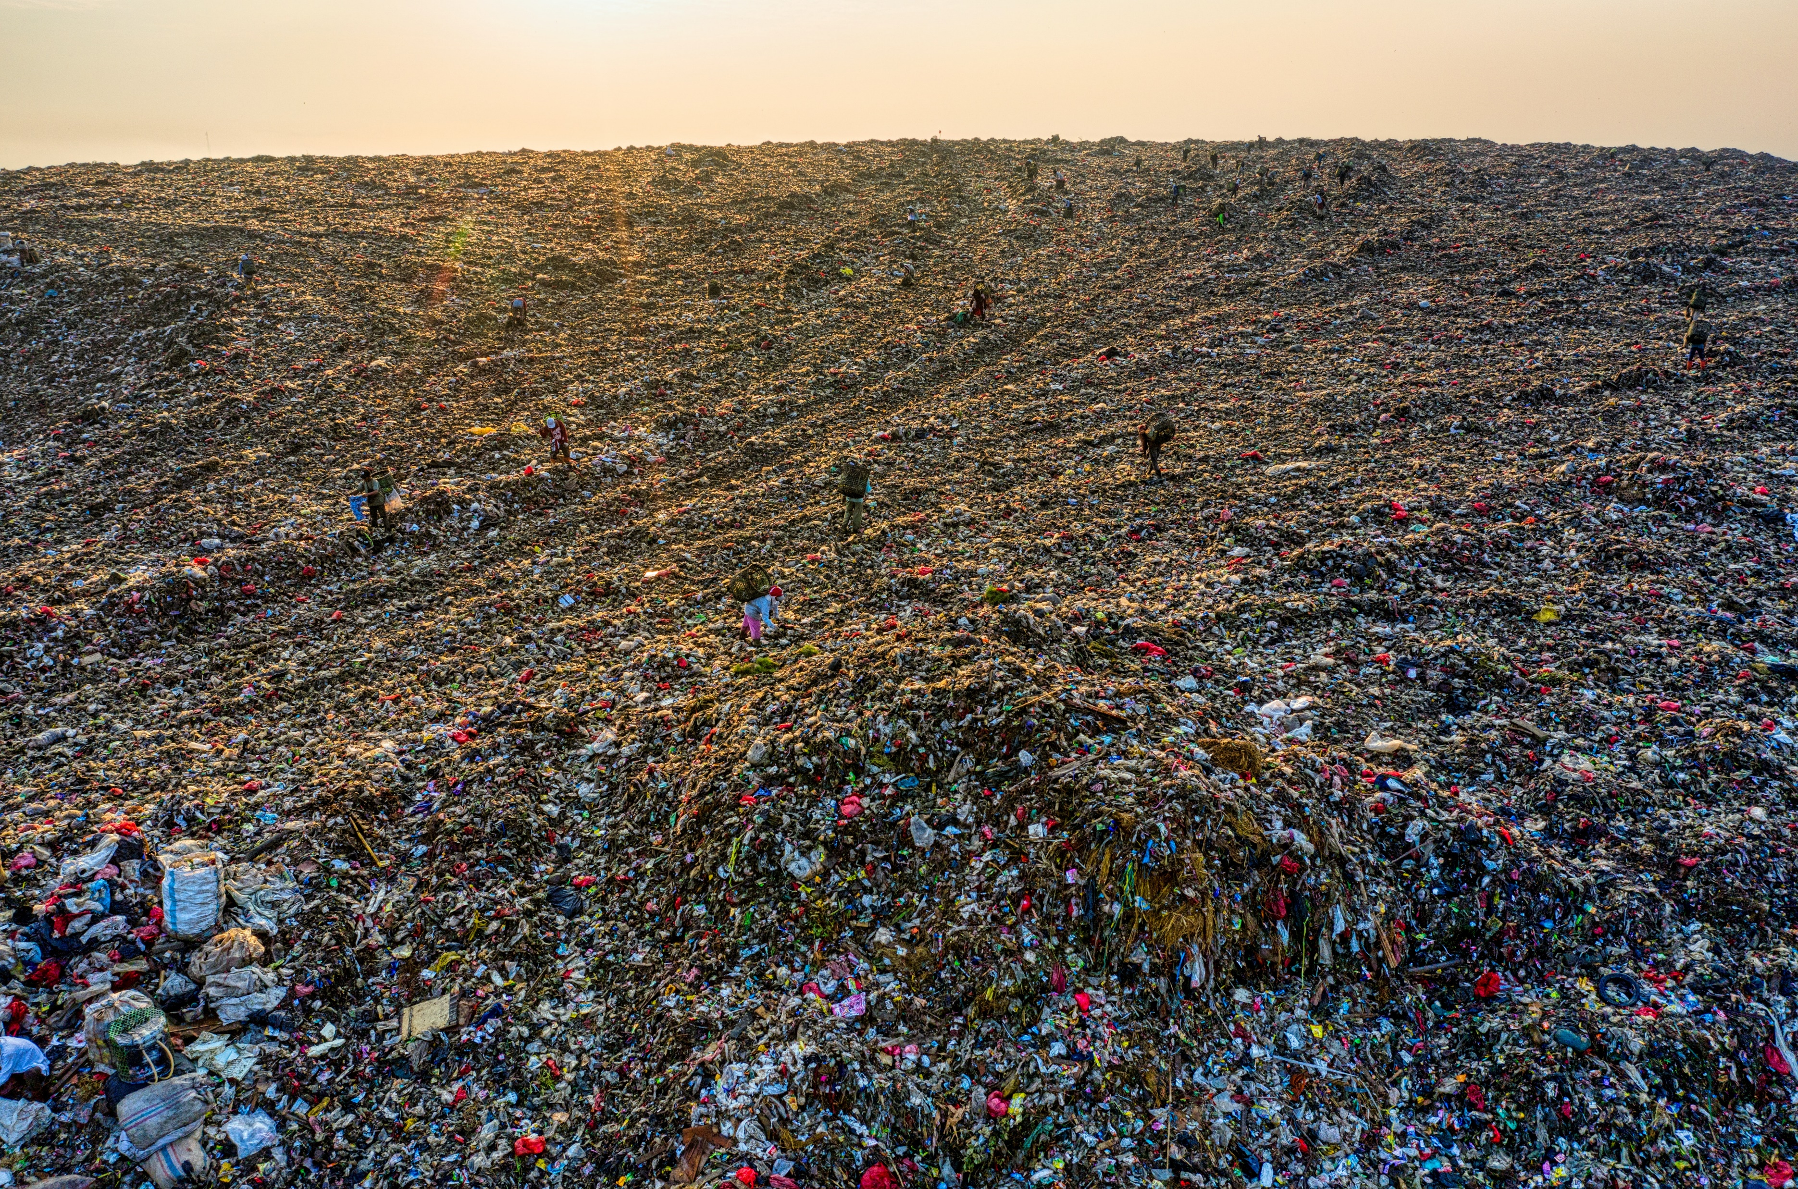
RECYCLING
Pic: Tom Fisk
Notes:
But hey, we are recycling, aren’t we? Sorry to disappoint you – but we are not.
Worldwide, only 17% of e-waste is collected
The other part is illegally exported, burnt or recycles under very unhealthy conditions.
And only a small percentage of that is actually properly recycled – the remaining part is burnt or ends up in a landfills.
Why only so few? The problem with recycling electronic components is, that its technically very
challenging to separate the different materials.
It’s like a ratatouille of vegetables – hard to split into its original vegetables.
In addition, the recycled materials end up having a lower quality.
----
https://www.pexels.com/photo/aerial-footage-of-landfill-during-dawn-5424851/

Slide 5
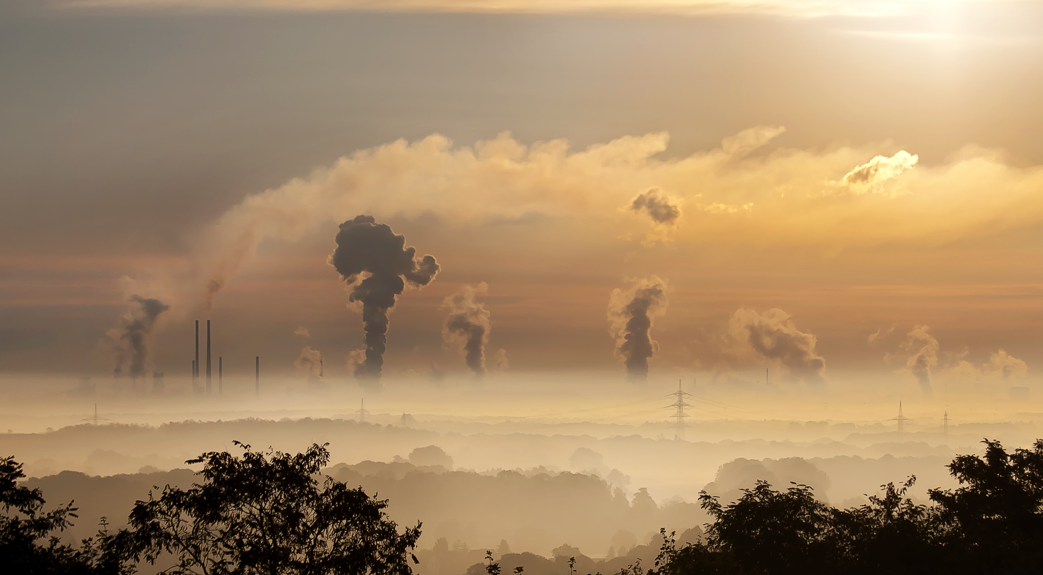
GREENHOUSE GAS EMISSIONS
Notes:
Let’s jump to another negative point: the greenhouse gas emissions.
Worldwide, 80% of the produces energy is based on fossil fuels.
This is the energy used to power endusers devices, network infrastructure and datacentres – so while we use the devices. The use phase.
And then there are also emission from mines and factories during the production phase. These emissions are often referred to as embodied emissions. This laptop for example, has embodied emissions of about 200kg

Slide 6
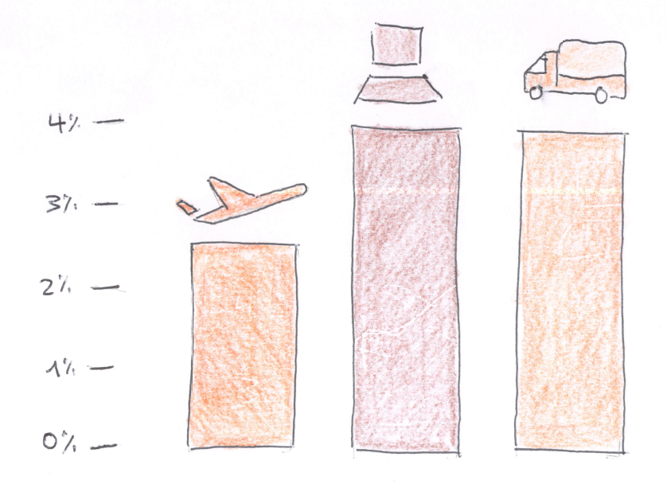
GREENHOUSE GAS EMISSIONS
Source: Digital Collage
Notes:
The digital sector is responsible for about 4%
Of the global greenhouse case emissions.
That is more than the aviation industry,
And almost on par to the worldwide fleet of trucks.
And the scary thing is: digitalization in general
and technologies like AI or IoT in particular
boost the usage of digital technologies
And with that lead to an ever increasing footprint –
while to fight climate change a decrease should be the direction to go.
Dirty industry
How to reduce the impact – specifically regarding the greenhouse gase emissions?
Lots of measures
Order of magnitude
Do math myself

Slide 7
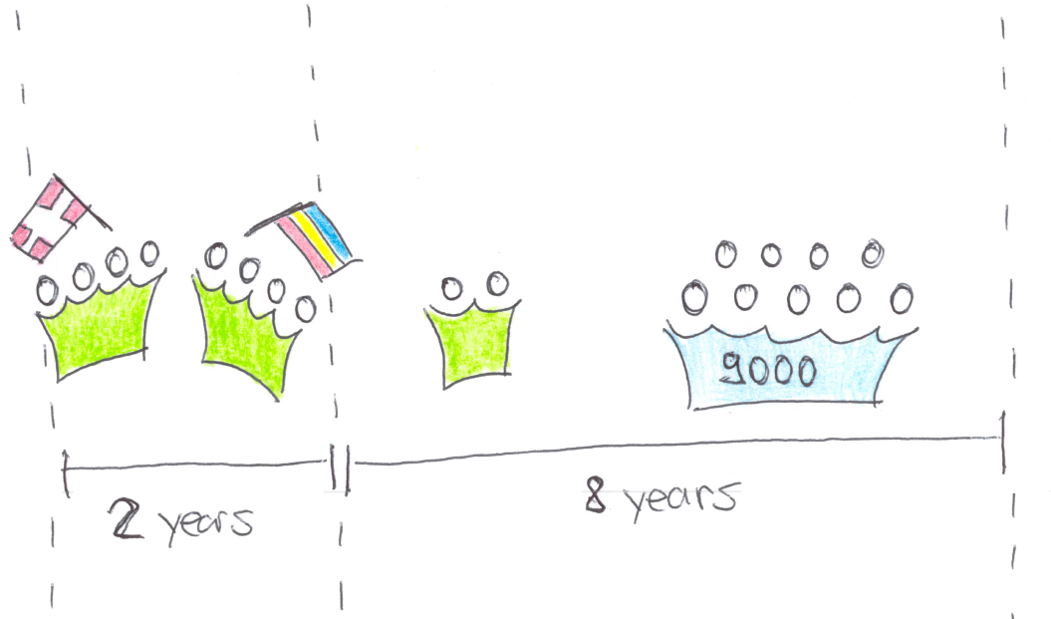
SIMULATED PROJECT
Notes:
To figure out how these impacts relate to my project work,
I calculated the carbon emissions of an average project myself.
I made a model for a project which consists of two phases:
Phase 1 takes 2 years and is the development phase.
8 engineers work on it in a distributed manner.
Phase 2 is the production phase and it takes 8 years.
There are 2 engineers working on operations and small developments
And then there are 9000 business users.
It is a line of business applications for a European company
and every users uses it for 2-3 hours per working day.

Slide 8
Total emissions
Enduser
90%
900 t
Dev & Ops
10%
100 t
Notes:
And that is what my model spit out: 1000t of carbon emissions.
The end users account for about 90% of the carbon emission.
That would be mainly the production of end users devices and their usage.
The remaining 10% is for development and operations.
Mainly the production of the software and datacentre emissions.

Slide 9
Total emissions SANITY CHECK
Enduser
90%
900 t
Production &
Enduser Use
65%
Dev & Ops
10%
100 t
Datacentres
& Network Use
35%
Energy consumption
in Digital Sector
Notes:
As I said, I built up a model – and all models are wrong.
So I tried to find out: how accurate are my findings?
I found a study from the Shift project from 2017 which says,
that 65% of the electricity consumption of the whole digital sector goes into production of equipment and enduser usage.
And the remaining 35% are for.
That does not quite fit my numbers
And when you look at the details, it is actually quite a stretch to compare the two.
but nonetheless, it shows a tendency: the end users cut on the emissions are far higher than the emissions from datacentres and networks. This is mainly due to the fact, that there are more end user devices. And also here: growing in numbers:
Who brought 1 device (with a screen: phone, laptop, watch, tablet) today? Who brought 2 devices? Who brought more? The tendency is towards more enduser devices. To tackle that we have to make sure, our software works as long as possible and does not make enduers hardware obsolete. So that devices can be uses as long as possible. That Another topic is the energy source of the end user devices.

Slide 10
Total emissions
deep
dive
Enduser
90%
900 t
Dev & Ops
10%
100 t
Notes:
But today, since this is a DevOps meetup, we are going to focus on the smaller cut, the 10% for development and operations.
Let’s take a deep dive here
In the area we can influence directly

Slide 11
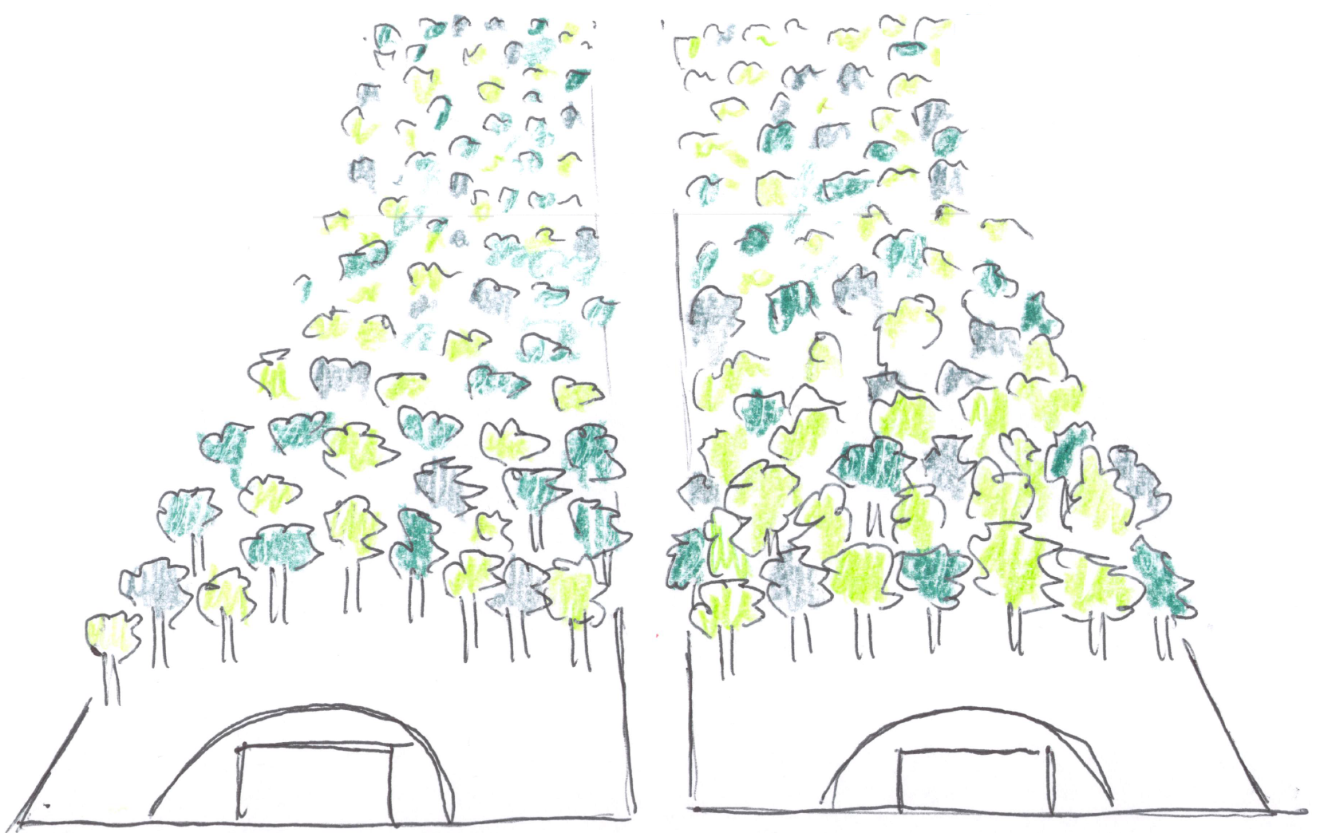
GREENHOUSE GAS EMISSIONS (DEV&OPS)
Notes:
So to imagine what 100t mean
That is 300 000 fire extinguishers
Or
2 footbal fields, during 10 years
----
https://www.pexels.com/photo/sky-clouds-building-industry-39553/

Slide 12
Total emissions
Engineers
Servers
Network Traffic
Notes:
Engineers: 65%
DevBoxes, Screens
Travel
Commute
Eat
Servers: 31%
Production, Staging, Test
CI/CD solution
Equals to 31t over 10years -> roughly 3t year
Lufthansa Industry Solutions performed a software lifecycle assessment for a backend service software, running 24/7 with 2-3 requests per second and came to roughly 1t per year
Network Traffic 4%
- To end users
Let’s reduce these emission
ordered by their impact in the simulated software

Slide 13
Work in the same country
25%
Notes:
Avoiding flights

Slide 14
CUtting the number of cores and the memory in half
15%
25%
Notes:
VM
Case for optimized programming
Or to avoid overprovisioning

Slide 15
increase power usage EFFICIENCY by moving to a HYPERSCALER + lower emission factor per kwh
8%
Notes:
PUE from 2 to 1.1
Greener energy products

Slide 16
Switch off unused resources (i.e. outside of business hours)
8%

Slide 17
Decomission the 30% of zombie resources
7%

Slide 18
USE CLOUD BASED CI/CD solution
7%

Slide 19
USE A GREEN ENERGY PRODUCT
7%
Notes:
ProNatur: 19g/kwH
CH consumption: 153g/kwh
Easter Europe: 500g/kwh

Slide 20
INCREASE HOME OFFICE FROM 1 TO 3 DAYS
7%
Notes:
Avoiding commute
Other measures with the same angle
Means of transport

Slide 21
Eat Vegetarian lunches
6%

Slide 22
EXTENDING HARDWARE LIFESPAN BY ONE YEAR
5%
Notes:
Gain comes from embodied emissions

Slide 23
Relaxing hot-standby requirements - use IaC
4%

Slide 24
REDUCING network TRAFFIC BY 25%
3%
Notes:
Not a traffic intensive application
Don’t apply it to your scenario 1:1
And another warning: it’s not scientific!

Slide 25
Combined measures
75% reduced
25%
Notes:
Cannot just add together
Saved 75tons!

Slide 26
Combined effort
25%
Notes:
Now, you probably can not apply all the measures in your projects.
But even if everybody in this room applies one of the measures we can already save tons of emissions.

Slide 27
github.com/abeggchr/ environmental-impact-estimator
Notes:
You find all the calculations in my github repo
And I look forward to exchange on it
So, to close:
Let us reduce the environmental impact of the software you are building
and let's make sure we can continue to contribute to the progress of human kind
- instead of having to use the fire extinguishers to save us!

